Slide 1

Alternative Powered Vehicles

Slide 2
What is an Alternatively powered Vehicle?
Definition:
A vehicle that runs on a fuel other than traditional gasoline or diesel; any method of powering an engine that does not involve petroleum.

Slide 3
Renewable
Unlike Petroleum based fuels, alternative fuels are typically renewable.
  excluding gasoline hybrids.
Renewable?
  Means that the fuel can be replenished once used.
  EX: Ethanol is made from corn. Since corn can be grown repeatedly it is inturn renewable.

Slide 4
Why Have Alternatively Powered Vehicles?
Environmental:
  Environment continues to be polluted, smog increases….
Dwindling Resources & Economics:
  Oil is becoming limited and expensive.
Political:
  Increasing international pressure to clean up the environment.

Slide 5
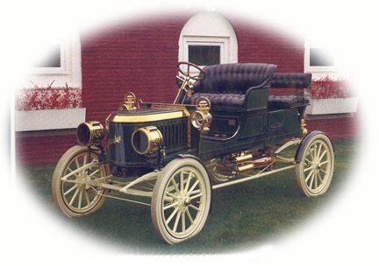
History
Alternate fuels have been around as long as automobiles.
Stanley Steamer, invented in 1906

Slide 6
Main Alternate Transportation Fuels
Bio-Alcohol:
  Ethanol/Methanol
Bio-Diesel:
  Refined Vegetable Oil
Electric:
  Chemically Stored energy
Hydrogen:
  Fuel Cell or Gas
Non-Fossil Methane & Natural Gas:
  Poo Gas & Naturally occurring Gas deposits

Slide 7
Hybrid Technologies
Many vehicles combine one of the alternate fuel power sources with a traditional petroleum burning engines
Gasoline & Battery Power
Gasoline & Ethanol

Slide 8
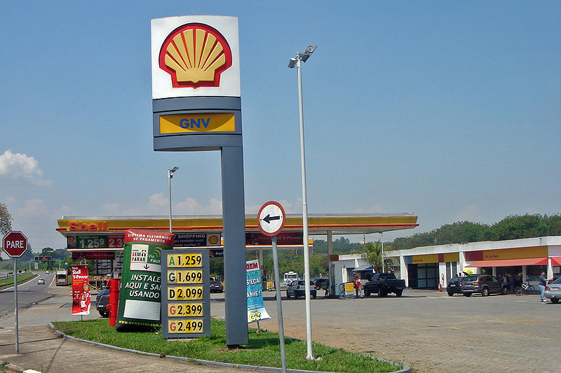
Alternative Popularity
Initially very little interest, but is slowly becoming more and more prevalent in different areas.
Typical Brazilian filling station with four alternative fuels for sale:
Biodiesel (B3),
Gasohol (E25),
Pure Ethanol (E100),
Compressed natural gas (CNG).

Slide 9
Advantages
&
Disadvantages of
Alternate Fuels
(Group Work)

Slide 10

SOLAR MODEL PROJECT

Slide 11
Solar Car Project
Introduction & Handouts:
!!Solar RACECARS!!
Assigned groups (same as Pro/Con Excersize)
Any Questions?

